Slide 1
Algorithm Analysis
Fall 2024
School of Software Engineering
South China University of Technology

Slide 2


Content
Simple Model of Computation
Definitions of Big-Oh and Other Notations
Common Functions and Growth Rates
Worst Case vs. Average Case Analysis
How to Perform Analyses
Comparative Examples

Slide 3

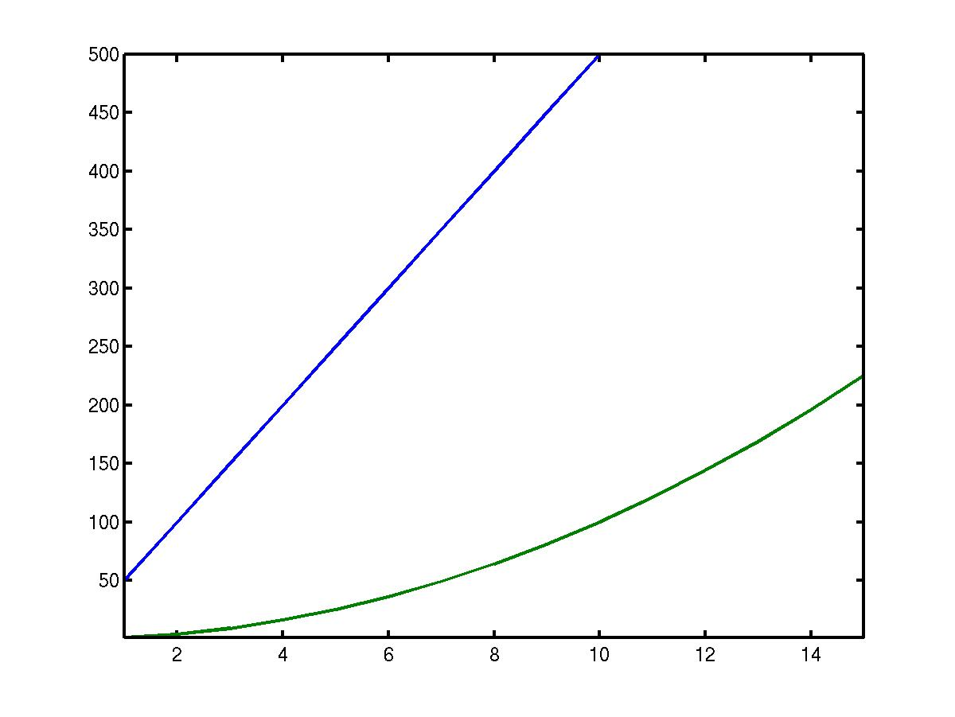
Algorithm Analysis
1. Why do we analyze algorithms?
Suppose you are given two algorithms A and B for solving a problem.
The running times T_{A}(N) and T_{B}(N) of A and B as a function of input size N are given
T_{A}
Run Time
T_{B}
Input Size N
Which is better?

Slide 4
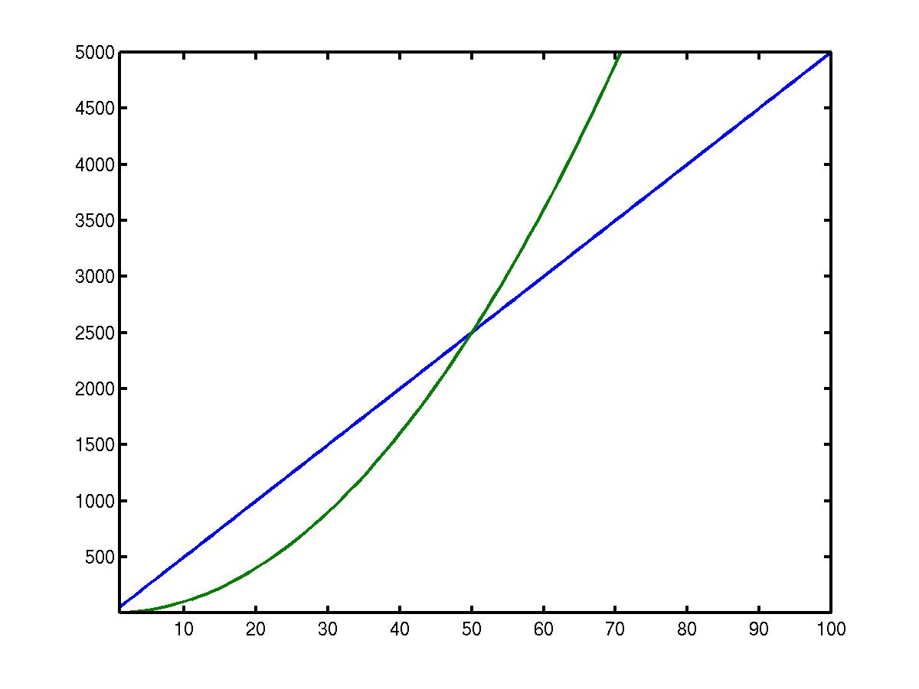
Algorithm Analysis
1. Why do we analyze algorithms?
For large N, the running time of A and B is:
Run Time
T_{A}(N) = 50N
Now which algorithm would you choose?
T_{B}(N) = N²
Input Size N

Slide 5
Algorithm Analysis
1. Why do we analyze algorithms?
2. How do we measure the efficiency of an algorithm?
A. Time it on my computer.
B. Compare its time to that of another algorithm that has already been analyzed.
C. Count how many instructions it will execute for an arbitrary input data set.

Slide 6
Algorithm Analysis
Suppose the input is of size n
We’d like to find a time function T(n) that shows how the execution time depends on n.
T(n) = 3n + 4
T(n) = e^{n}
T(n) = 2

Slide 7
Model of Computation
Simple Model of Computation
instructions are executed sequentially
has the standard repertoire of simple instructions
it takes exactly one time unit to do addition, multiplication, comparison, and assignment
assume that the model has fixed-size integers(ex. 32-bits) and no fancy operations, e.g. matrix inversion or sorting
assume infinite memory

Slide 8
What to Analyze
What to Analyze
Running time required
Memory or disk space required to run the program and store the data structure
Main factors
the algorithm used
the input to the algorithm
Not include the programming language, compiler,…
Analyze the algorithms rather than the programs

Slide 9
Mathematical Definitions
Big-Oh
Big-Omega
Big-Theta
Little-oh
T(N) = O(f(N)) if there are positive constants c and n₀ such that T(N) ≤ cf(N) when N ≥ n₀.
T(N) = Ω(g(N)) if there are positive constants c and n0 such that T(N) ≥ cg(N) when N ≥ n0.
T(N) = Θ(h(N)) if and only if T(N) = O(h(N)) and T(N) = Ω(h(N)).
T(N) = o(p(N)) if, for all positive constants c, there exists an n₀ such that T(N) < cp(N) when N > n₀.

Slide 10
“Big-Oh”
T(N) = O(f(N)) if there are positive constants c and n₀ such that T(N) ≤ cf(N) when N ≥ n₀.
We say “T(N) has order f(N).”
“f(N) is an upper bound on T(N)”
We try to simplify T(N) into one or more common functions.
Ex. 1 T(N) = 3N + 4
T(N) is linear. Intuitively, f(N) should be N.
More formally,
T(N) = 3N + 4 ≤ 3N + 4N, N ≥ 1
T(N) ≤ 7N, N ≥ 1
So T(N) is of order N.
Ex. 30N+8 is O(N), c=？n₀=？

Slide 11
“Common Functions to Use”
O(n²) quadratic
O(n³) cubic
O(2^{n}) or O(e^{n}) exponential
O(n+m)
O(nm)
O(n^{m})
O(1) constant
O(log n) log base 2
O(n) linear
O(n log n)

Slide 12
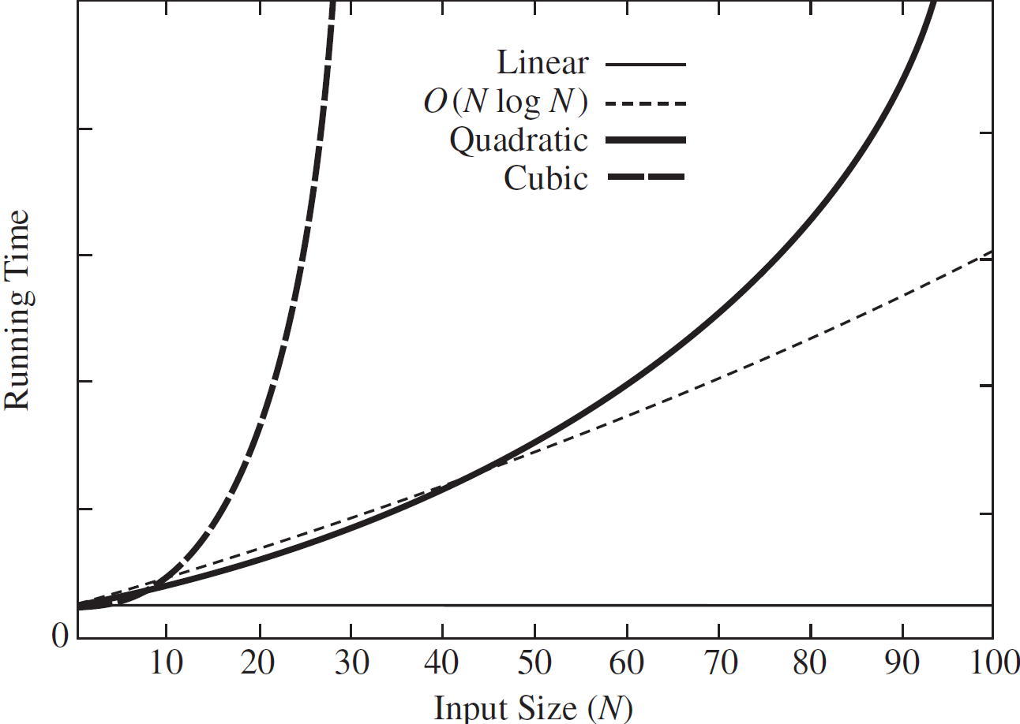
Growth Rates
The idea of the definitions is to establish a relative order among functions.
The growth rate is the rate at which the cost of the algorithm grows as the input size grows.

Slide 13
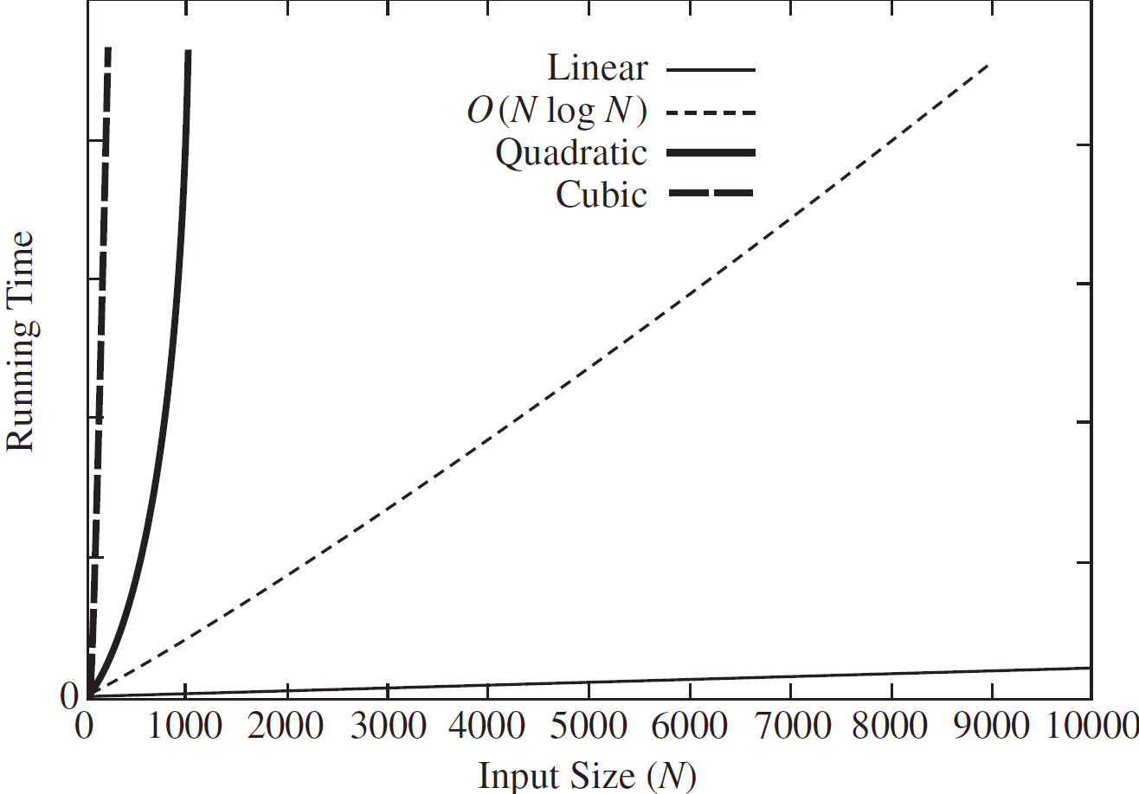
Growth Rates
The idea of the definitions is to establish a relative order among functions.
The growth rate is the rate at which the cost of the algorithm grows as the input size grows.
O(1) < O(logn) < O(n) < O(nlogn) < O(n²) < O(n³) < O(2^{n}) < O(n!) < O(n^{n})

Slide 14
“simplifying rules”
Rule 1: If T1(N) = O(f (N)) and T2(N) = O(g(N)), then
T1(N) + T2(N) = O(f (N) + g(N))
T1(N) ∗ T2(N) = O(f (N) ∗ g(N)).
Suppose we get T₁(N) = O(f(N)) and T₂(N)=O(g(N)),
啊
f(N) = 4N² + 6, g(N) = 3N , T(N) = T₁(N)+T₂(N) =?
啊
T(N) = T₁(N)+T₂(N) = O(f(N) + g(N))
= O(4N² + 3N + 6)
= O(N²)
intuitively O(max(f (N), g(N)))

Slide 15
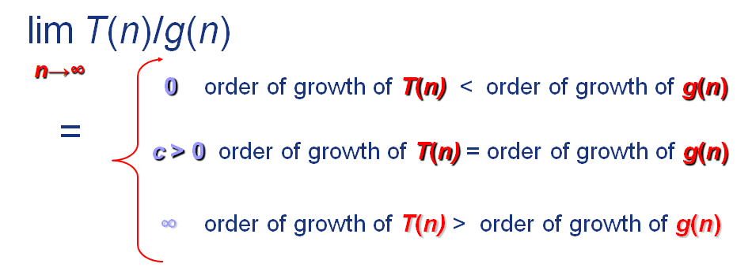
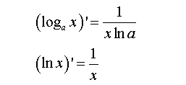
“simplifying rules”
Rule 2: If T(N) is a polynomial of degree k, then T(N) = Θ (N^{k}).
Rule 3: log^{k}N = O(N) for any constant k.
Rule 4: If T(n) = O(g(n)) and g(n) = O(h(n)), then T(n) = O(h(n)).
– transitive*
Rule 5: If T(n) = O(kg(n)) for any constant k > 0, then T(n) = O(g(n)).
– ignore the constant*.

Slide 16
“Common Functions to Use”
Suppose we get T(N) = 4N² + 3N + 6.
Is T(N) = O(N²)?
Is T(N) = O(N³)?
Generally, we look for the smallest f(N) that bounds T(N).
We want a common function that is a least upper bound.
If T(N) = c_{k}N^{k} + c_{k-1}N^{k-1} + ... + c₀ .
T(N) = O(N^{k}).
N^{k} is the dominant term.

Slide 17
How to Analyze
How to analyze
Asymptotic algorithm analysis
Measures the efficiency of an algorithm, as the input size becomes large – growth rate.
best-case
average-case
worst-case
, often of little interest
, often reflects typical behavior
, represents a guarantee for performance on any possible input.
Need to know enough about the input data distribution to do average-case analysis
Notes:
Ex. worst-case analysis is important for some real-time applications such as air traffic control system

Slide 18
How to Analyze
Given an array containing n integers, suppose the sequential search algorithm is adopted
a
Q1: The cost for finding a particular value K
May be different for different inputs
Best case:
if the first integer is K – examine 1 value
Worst case:
if only the last integer is K – examine n values
Average case:
If the sequential search is performed on different inputs for many times – examine (n+1)/2 values on average
Q2: The cost of finding the largest value
Always c*n

Slide 19
How to Analyze
Step 1. Counting T(N)
Step 2. Simplifying O(f(N))
//Loop
int sumit( int v[ ], int num) {
sum = 0;
for (i = 0; i < num; i++)
sum = sum + v[i];
return sum
}
c1
c2*num
c3*num
c4
T(num) = (c2 + c3)* num + (c1 + c4)
= k1 * num + k2
= O(num)
throw away leading constants
We say T(n) of the algorithm is in O(n)
Notes:
The time cost by a basic operation does not depend on the particular values of its operands.

Slide 20
How to Analyze
// Nested Loops
int sum(int n) {
int sum = 0;
for (i=1; i<=n; i++)
for (j=1; j<=n; j++)
sum++;
}
c1
c2*n
c3*n
c4*n²
T(n) = c1 + (c2 + c3)*n + c4*n²
= O(n²)
throw away low order terms
We say T(n) of the algorithm is in O(n²)

Slide 21
How to Analyze
// compare the cost of the two loop codes
sum = 0;
for(k=1; k<=n; k*=2) //do log(n) times
for(j=1; j<=n; j++) //do n times
sum++;
In this double loop, the cost is
Notes:
The time cost by a basic operation does not depend on the particular values of its operands.

Slide 22
How to Analyze
// compare the cost of the two loop codes
sum = 0;
for(k=1; k<=n; k*=2) //do log(n) times
for(j=1; j<=k; j++) //do k times
sum++;
In this double loop, the cost is
Notes:
The time cost by a basic operation does not depend on the particular values of its operands.

Slide 23
How to Analyze
// assume array A contains n values,
// random takes constant time c₁ and
// sort takes cnlogn steps
for (i=0; i<n; i++) {
for (j=0; j<n; j++)
A[j] = random(n);
sort(A, n);
}
Determine Θ in average case
Θ(n(c₁n+cnlogn))= Θ(n²logn)
Notes:
The time cost by a basic operation does not depend on the particular values of its operands.

Slide 24
How to Analyze
// assume A[] contains a random permutation
// of the values from 0 to n-1
sum=0;
for(i=0; i<n; i++)
for(j=0; A[j] !=i; j++)
sum++;
7 | 5 | 2 | 1 | 0 | 4 | 6 | 3
j=0
j=1
j=4
Determine Θ in average case
Θ(n*(n-1)/2)=Θ(n²)
1/n * (0+1+…(n-1))= (n-1)/2
Notes:
The time cost by a basic operation does not depend on the particular values of its operands.

Slide 25
How to Analyze
// A simple assignment to // an integer variable a = b;
T(N) = Θ(1)
Notes:
The time cost by a basic operation does not depend on the particular values of its operands.

Slide 26
How to Analyze
While loop – similar to for loop
If-then-else statement – the greater of the costs for the then and else clauses.
Switch statement – the most expensive branch
Subroutine call – add the cost of subroutine
Recursive subroutine – express the cost by a recurrence relation and then find the closed-form solution.
Notes:
Ex. worst-case analysis is important for some real-time applications such as air traffic control system

Slide 27
How to Analyze
// Here || is the string concatenation operator
string t (int n){
if (n == 1) return ‘(1) ‘;
else return ‘(‘ || n || t(n - 1) || ‘) ‘
}
T(n) = T(n-1) + c , for n>1, with T(1) = c₁
That is ,
T(n) = T(n-1) + c = (T(n-2) + c) + c
= … = T(1) + (n-1) * c
T(n) = c*(n-1) + c₁ = Θ(n)
Notes:
The time cost by a basic operation does not depend on the particular values of its operands.

Slide 28
How to Analyze
// Multiple Parameters
// A picture with P pixels; each pixel takes one of C color
// values; Sort the colors w.r.t. the number of pixels with
// the color (Θ(C log C) )
for (i=0; i<C; i++) // Initialize count
count[i] = 0;
for (i=0; i<P; i++) // Look at all pixels
count[value(i)]++; // Increment count
sort(count); // Sort pixel counts
The cost is Θ (C) + Θ(P) + Θ(C log C) = Θ(P + C log C)
Can we drop Θ(P) or Θ(C log C)?

Slide 29
Notes
Best, Worst, Average-Cases
vs.
Upper, Lower Bounds
U/L bounds refer to the algorithm’s growth rate.
B/W/A cases refer to a certain type of inputs which cause the shortest/average/longest running time among all the inputs in study.
U/L bounds can be used to describe the running time of an algorithm in its [best, worst, average] case

Slide 30
Notes
For an algorithm with T(n) = c₁n²+c₂n in the average case (c₁, c₂>0) ,
c₁n²+c₂n <= (c₁+c₂)n² for all n>1, T(n) <= cn² for c=c₁+c₂ and n₀=1.
c₁n²+c₂n >= c₁n² for all n>1, T(n) >= c₁n² for n₀=1.
T(n) is in Θ(n²) in the average case
Reading the value from the first position in an array takes constant time regardless of the size of the array.
T(n) = c for the (best, worst, and average) cases.
Traditionally, we say that the algorithm is in O(1).

Slide 31
Notes
Analyze an algorithm
vs.
Analyze a problem
The upper bound for a problem cannot be lower than the upper bound for the best known algorithm
理论上，问题的上界不依赖于当前已知的算法。一个问题的上界可能会随着新算法的发现而改变，但在给定的时间点上，问题的上界不能低于当前已知的最佳算法的上界。
If a problem is in Ω(f(n)), every algorithm that solves the problem is in Ω(f(n)), even algorithms that we have not thought of. ---解决一个问题至少要f(n)的计算量，所有算法都至少要这么多计算量

Slide 32
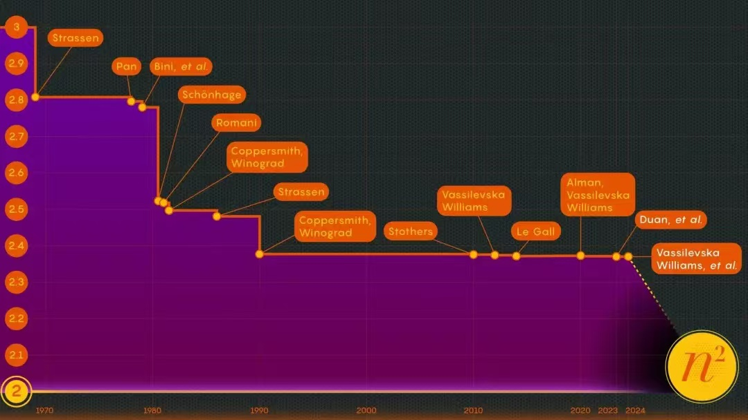

Slide 33
Notes
Other kinds of analysis
Amortized –worst case averaged over a sequential operations
Textbook Chapter 11
Common case – 80%-20%

Slide 34
Homework
Read textbook Ch2. Please pay more attention on section 2.4.3 “the Maximum Subsequence Sum Problem”
Exercise 2.7 3) and 4)
Exercise 2.20
Deadline: to be confirmed.

